Slide 1
Unified Data Infrastructure (UDI) for Service Integration and Interoperability (SII)
Federated UDI-SII for Healthcare Domain

Slide 2

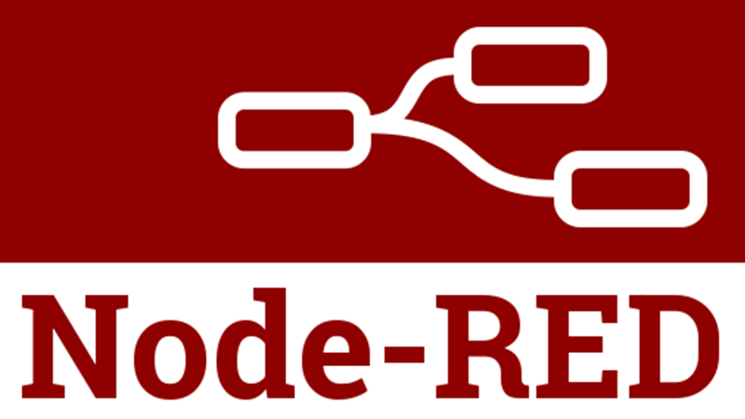











Unified Data Infrastructure (UDI) for Services Interoperability
Data Providers
Ingestion and Staging Vaults (ISVs)
Integration Data Vaults (IDVs)
Presentation
Services
UMLS or Ontology (Protégé)
Orchestration services for complex ELT
Information
Data Consumers
Custom Receiver
HL7
FHIR Server
REST API
Staging Data Vault
Raw Data Vault
FAX
FTP -> XML, CSV
Unified Star Schema
CCD, etc.
Only for Complex ELT
Authorization DSL
Data Vault/ Views
Structured Files
ELT Procedures with RLS
Legacy SQL DB
Legacy SQL FDWs
Mobile Application
For Governance
Legacy ELK
ELK FDWs
Analysis & Reports
Unstructured Files
FHIR taxonomy, codesets, terminology, nomenclature for information model in integration and presentation layers where appropriate and possible
File Watcher (Cron)
Server
SMART on FHIR Container
Web Application
Client
ELT : Extraction, Loading & Transformation
Schema.org like universal data model wherever needed.

Slide 3
References
UDI- https://future.com/emerging-architectures-modern-data-infrastructure/
HL7 – https://hl7.org/
FHIR- https://hl7.org/FHIR/
Secure Cloud Faxing Integration- https://www.healthcareittoday.com/2022/08/22/integrating-digital-fax-into-your-health-it-solution
FDWs - https://wiki.postgresql.org/wiki/Foreign_data_wrappers
ELK FDW - https://github.com/matthewfranglen/postgres-elasticsearch-fdw
Node-Red https://nodered.org/
GraphQL - https://graphql.org/
Mirth Connect https://www.nextgen.com/products-and-services/integration-engine
MapForce https://www.altova.com/mapforce
Data hub - https://datahub.io/
Data Vault - https://www.data-vault.co.uk/what-is-data-vault/
USS - https://cdn.ttgtmedia.com/rms/pdf/The-Unified-Star-Schema.pdf
Microsoft FHIR Converter - https://github.com/microsoft/FHIR-Converter
SMART App Launch with Keycloak and the IBM FHIR Server https://alvearie.io/blog/smart-keycloak/
Keycloak extensions for FHIR https://github.com/Alvearie/keycloak-extensions-for-fhir
Using keycloak for SMART on FHIR https://wiki.openmrs.org/display/projects/Using+Keycloak+for+SMART-on-FHIR+Support
SMART on FHIR Server implementation https://confluence.hl7.org/display/FHIR/SMART+on+FHIR+server+implementations

Slide 4
Integration Methods
UDI-SII approach must be “Cloud first but On-Prem capable”
Cloud API Based Integration
OnPremise Platform-based Integration
CSV/Excel
FAX

Slide 5
Onboarding parties into UDI-SII
Institution onboarding – adding healthcare delivery organization (HDOs) like hospitals or physician practices.
Professionals and staff onboarding – adding credentialed healthcare delivery professionals (HDPs) like nurses and doctors, uncredentialed HDPs, and admin professionals
Patient onboarding for HDOs so they do not need to manually enter patients that are already in their EHR
Department onboarding- Adding hierarchy, and departments to the organization so that staff can easily onboard to it.
Staff onboarding for hospital users so they do not need to enter staff demographics and information that might be in their human resource system.

Slide 6
Points to be included
If the contents of the files from the Data Provider are in the form that can be stored in the satellite tables, it will go to staging data vault, otherwise it will go to file reference data vault.
Staging data vault contains proper hubs, links and satellite tables.
The data first comes to the staging area where it is stored in the Raw Data vault and then to Integration data vault which also has a staging section and transformation section. How to do transformation depend on Orchestration services (for complex ETL, we will use tools like Mirth Connect, Node Red, Altova MapForce etc.)
Sometimes orchestration is very simple which is view, sometimes a table transformation-where we actually transform things and sometimes it is very complex in which we need to extract things and OCR like faxes for example so we need an orchestration system like Node red, Mirth connect etc.
During orchestration if it's possible we have to use static Views first and then to Materialized views.
Practice Raw data vault in SQL lite.
The receiver will receive HL7 messages (or any other form of messages) and put it in Raw Data Vault and then in the Integration vault, we will create views for transformations or if it is very complex data to be extracted, use MapForce like tools to convert into JSON or XML like format and do the transformation in stored procedure. (SQL)
If we receive as JSON it goes in to Raw data vault as JSON itself.
We have Data Marts and views for presentation and service delivery.
FHIR specific transforms data vault in PostgreSQL.

Slide 7
UDI-SII – Discussion points
List out features of CO and point out current working and future plans ( Add a separate tab for Ingestion for HL7 and Ingestion for FHIR)
DO not focus entire UDI-SII first, Do UDI-SII for hospital-focused user personal workflow perspective
Look at CO workflow and prioritize Patient onboarding and staff boarding as the first one.
Patient needs to add to the CO, login, and workflow we can think about it later.
UDI-SII needs a middle area as an UDI-SII Data vault, From the Data vault it places into transactional systems and other parts.
UDI-SII Data Vault for staging and systems for integrating data before going into the system ( Decoupled)
Check the extension of FHIRbase, whether it supports non-health data, non-FHIR data, etc… one example is social determinants. (Data Vault vs database for FHIR (Fhirbase) )
Use syncthing instead of WebDAV for filing center
Use Node-red 3.0 for UDI-SII File Sync (EFSS)
Currently this is an architecture/design perspective talk, with no developers involved in this Integration part.
Create a CHBT component and UDI-SII component in the design diagram to compare the technologies.
UDI-SII approach must be “Cloud first but On-Prem capable.”

Slide 8
HL7
Hl7 data from client side is received either as FTP or a file. It can also be put in the Syncthing File Folder.
On the server side, receiving files in the FTP server or in the Syncthing server.
It is connected to a cron job or a file watcher to know when files are coming.
HL7 files will be staged as such in a Folder as well as in the staging Data Vault.
Transforms HL7 to JSON format using Mirth Connect/ Node-Red/ Altova MapForce.
It is then transformed to the hub and satellite tables in the Integration Data Vault.
The web application receives data from the Data Mart / Views.

Slide 9
FHIR
FHIR call from client side
On the Server side a Node application waiting to accept FHIR ( Asymmetric FHIR implementation)
Store FHIR data as it is in the staging Data Vault
Transform FHIR data to Hub and Satellite tables format which CO database procedures in the Integration Data Vault

Slide 10
UDI-SII Integration Types
The Following integrations types are as part of UDI-SII
Organization onboarding
Patient onboarding
Staff onboarding
Document Exchange (Inbound & Outbound)- API Model
Document Exchange using Direct Linking
Progress Note Integration
Discrete Data Exchange to third party applications
Email notification.
Excel based form Automation
Excel based Patient / Staff onboarding

Slide 11
Technology Stack
Area / Module | CHBT Technology/Feature | UDI-SII component
Data Staging | N/A - Direct | Data Vault
FHIR | Node.js, Asymmetrik FHIR Node Module
File Synch (EFSS) | Web-Dav | Syncthing
FHIR-SYNC | Node-RED 2.x | Node-RED 3.0
Cache Layer/Queue Management | Redis , Redissmq worker node.js Module
Logging | Winston Nodejs library
Tools / utilities | Nodejs Libraries for excel Integration, Mssql node js driver for SQL server as database engine, Node Libraries for

Slide 12
Thank You

